Slide 1
Data Structures and Algorithms Tutorial 4 – Binary Heap
Dr. Kok Hoe WONG

Slide 2
Topics
Binary Heap
Complete Binary Tree
Check if a binary tree is a complete tree
Binary Heap
Check if a binary tree is a binary heap

Slide 3
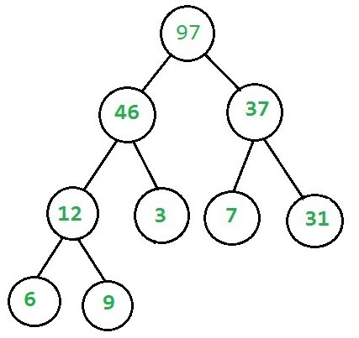
Binary Heap
It should be a complete tree (i.e. all levels except last should be full).
Every node’s value should be greater than or equal to its child node (considering max-heap).

Slide 4
Complete binary tree
Types of binary trees
Full binary tree : each node has either 0 or 2 children
Perfect binary tree : all interior nodes has two children and all leaves at the same level.
Complete binary tree : every level, except possibly the last, is completely filled, and all nodes in the last level are as far left as possible.
…

Slide 5






Which ones are complete binary tree?
(1) (2) (3) (4) (5) (6)
Notes:
Full binary tree (1)
Complete binary tree (2), (3)

Slide 6
If we use array to represent complete binary tree
If we represent the complete binary tree as an array from top to down and left to right.
If root is at index [0], one node is at index [i],
the parent of this node is at ⌊(i-1)/2⌋ if i≠0, i.e. integer division with truncation.
the left child is at [2i+1], and the right child is at [2i+2].

Slide 7
How to check if a tree is a complete tree?
Algorithm :
Calculate the number of nodes (count) in the binary tree.
Start recursion of the binary tree from the root node of the binary tree with index (i) being set as 0 and the number of nodes in the binary (count).
If the current node under examination is NULL, then the tree is a complete binary tree. Return true.
If index (i) of the current node is greater than or equal to the number of nodes in the binary tree (count) i.e. (i>= count), then the tree is not a complete binary. Return false.
Recursively check the left and right sub-trees of the binary tree for same condition. For the left sub-tree use the index as (2*i + 1) while for the right sub-tree use the index as (2*i + 2).
https://www.techiedelight.com/check-given-binary-tree-complete-binary-tree-not/
https://leetcode.com/problems/check-completeness-of-a-binary-tree/

Slide 8
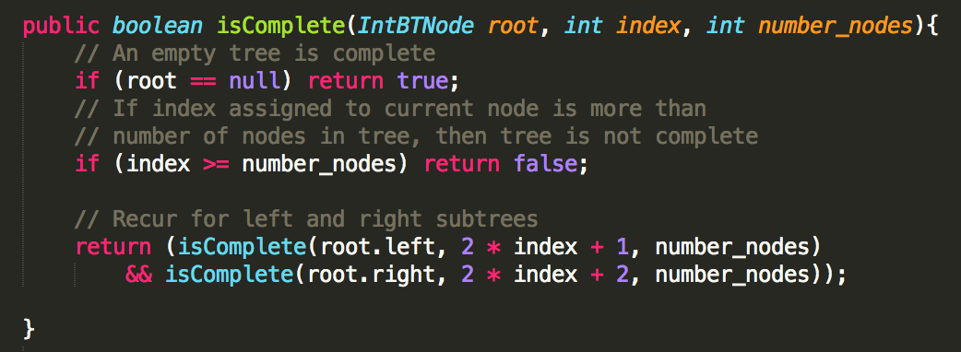
Notes:
Debug to see the algorithm steps or draw the steps in the white board.

Slide 9
Binary Heap
How do we check if a tree is a binary heap?
It should be a complete binary tree
Every node’s value should be greater than or equal to its child node (considering max-heap).

Slide 10
How to heck if a complete tree is a Heap?
Algorithm:
Every Node can have 2 children, 0 child (last level nodes) or 1 child (there can be at most one such node).
If Node has no child then it’s a leaf node and return true (Base case)
If Node has one child (it must be left child because it is a complete tree), compare this node with its left child.
If Node has both child then check heap property at Node at recur for both subtrees.

Slide 11
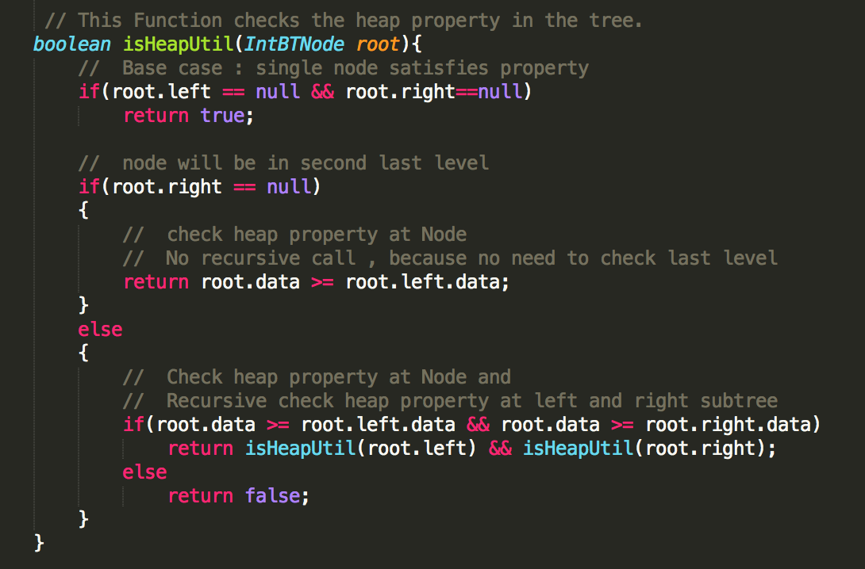

Slide 12
